Slide 1
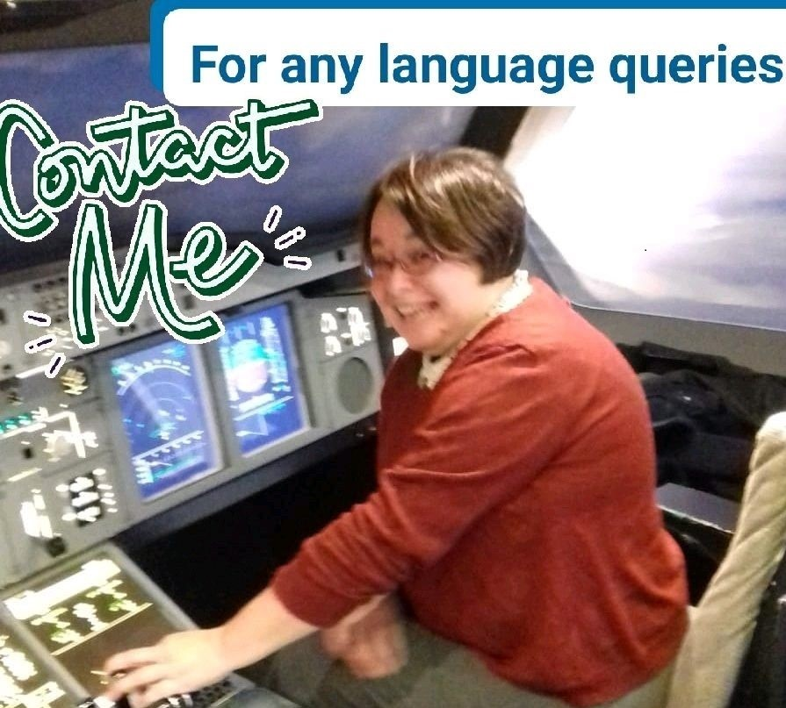
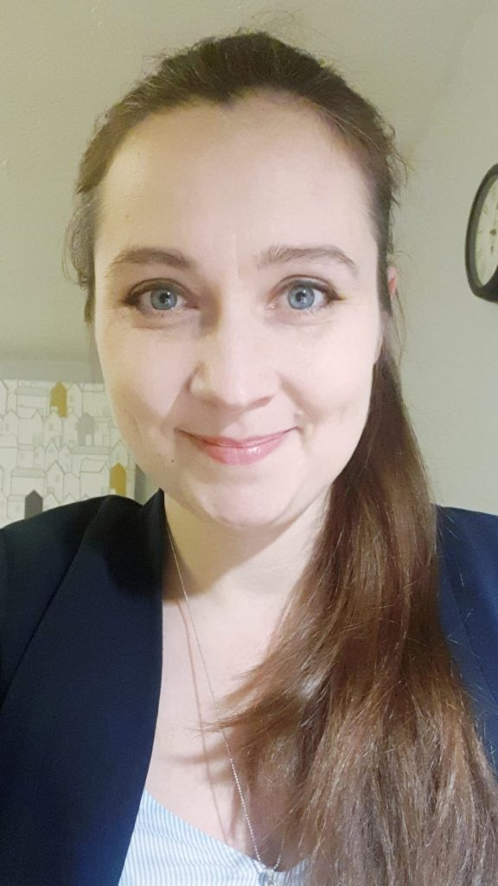
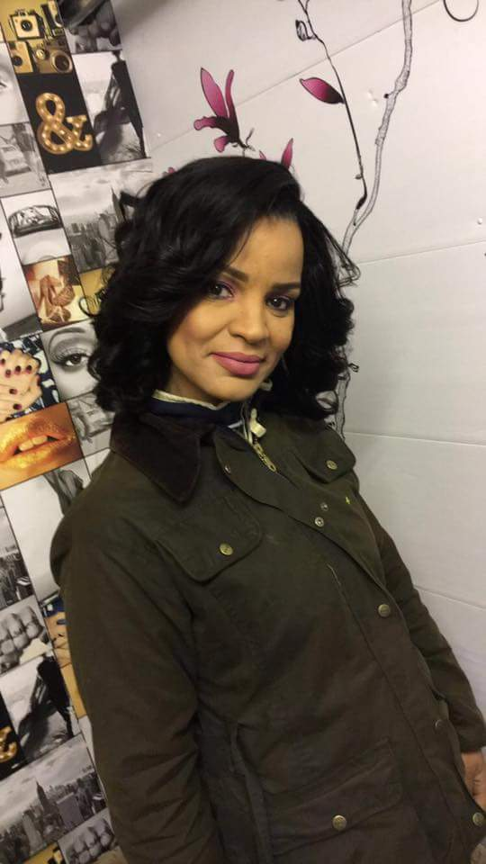
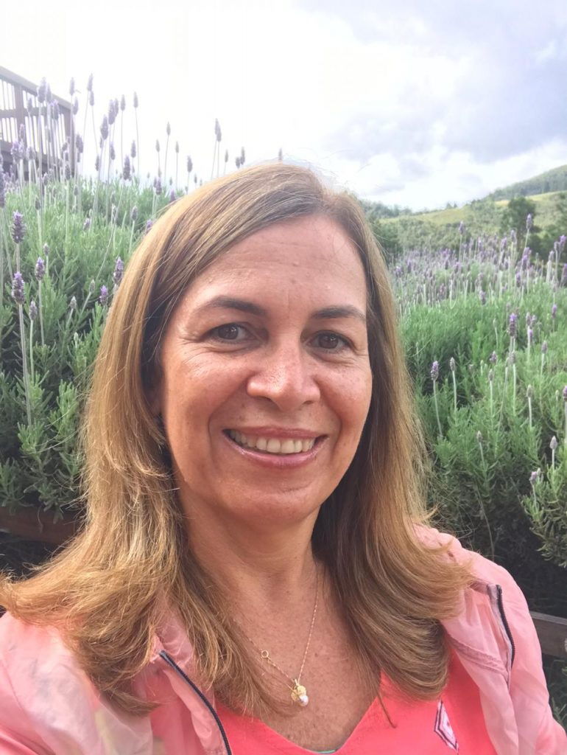
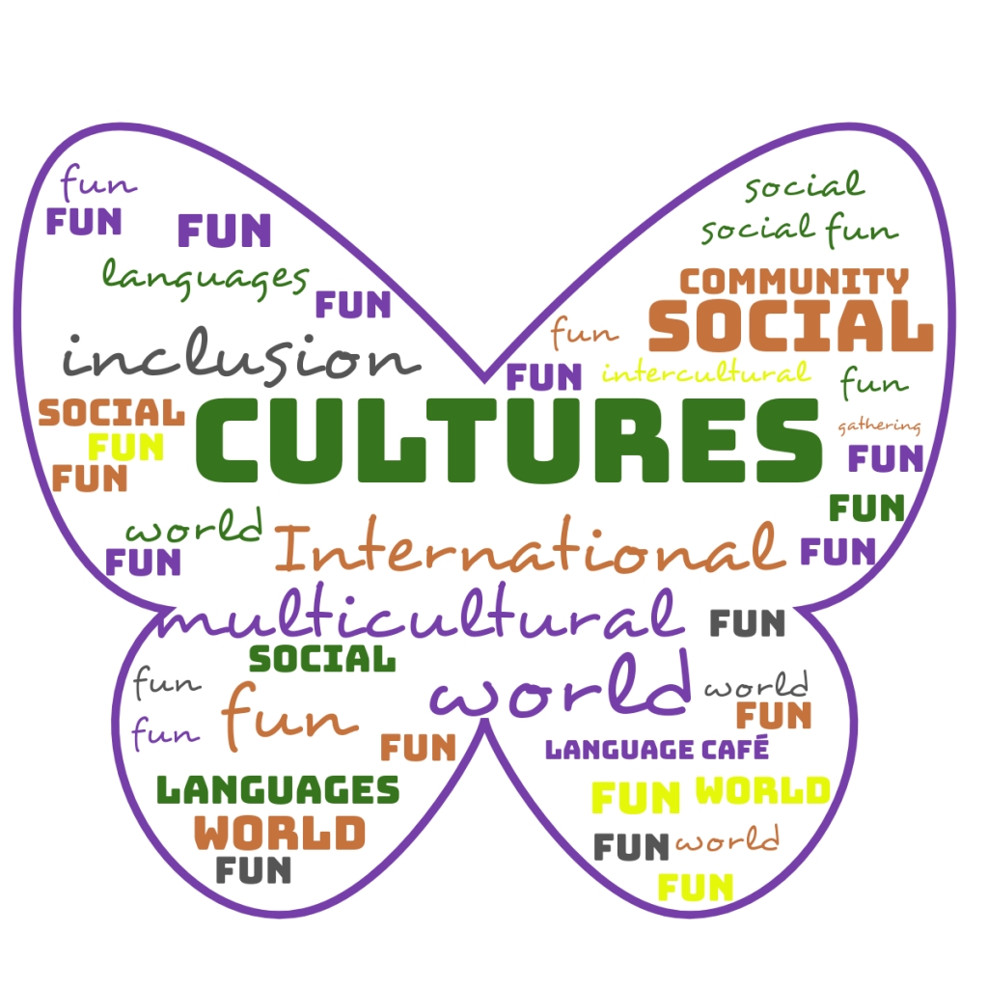
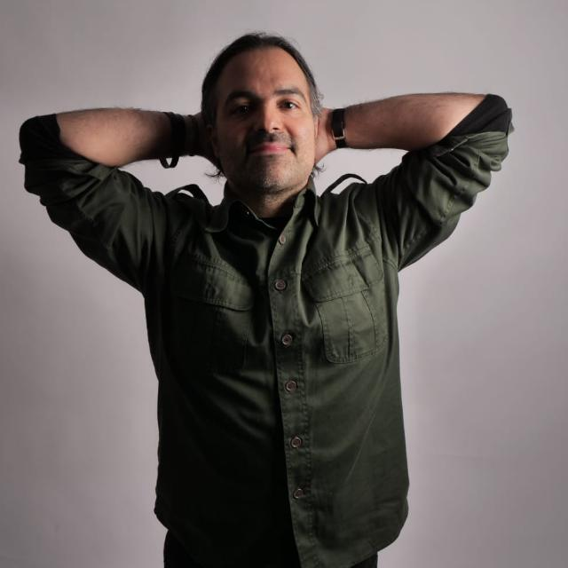
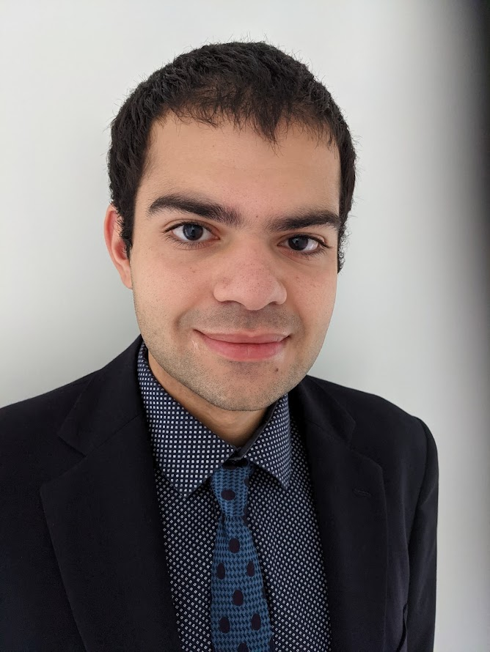
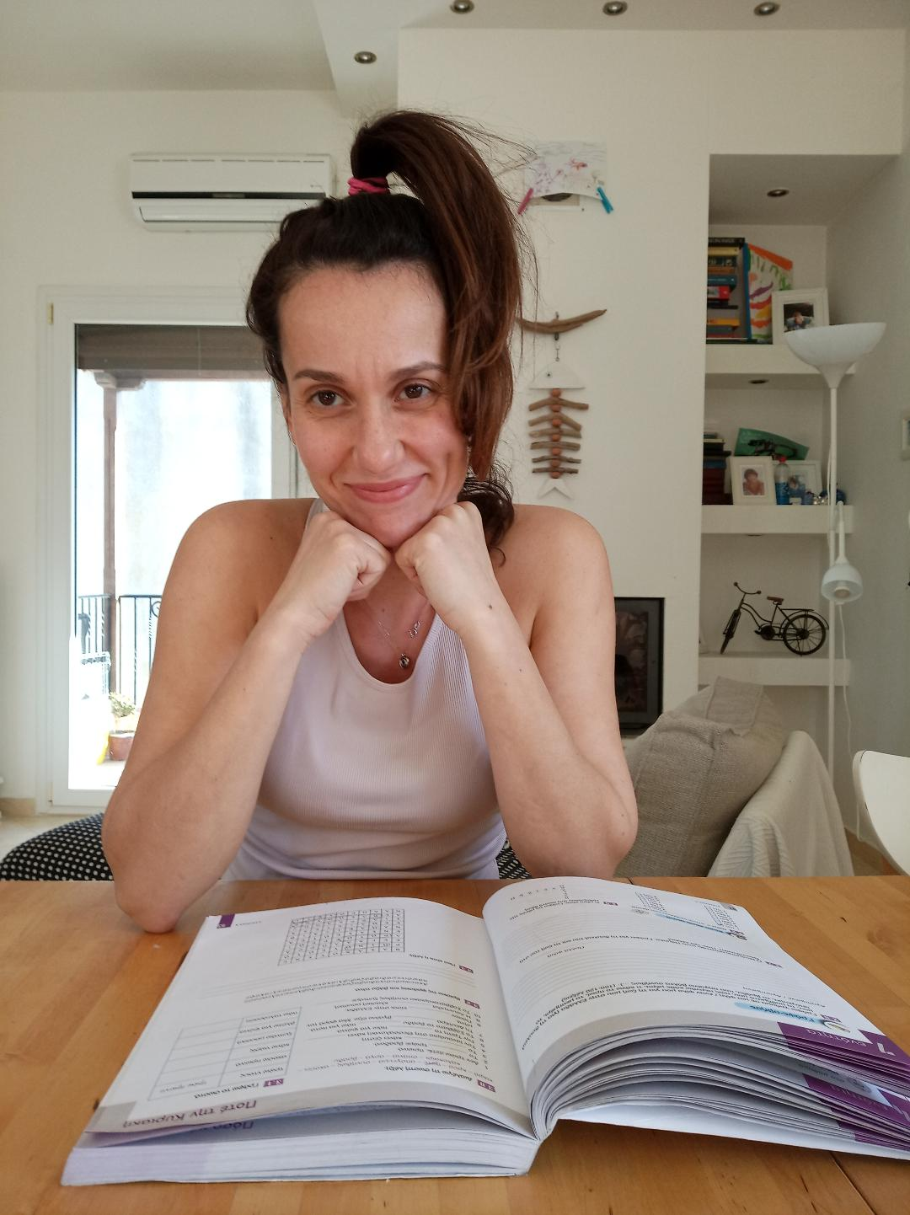
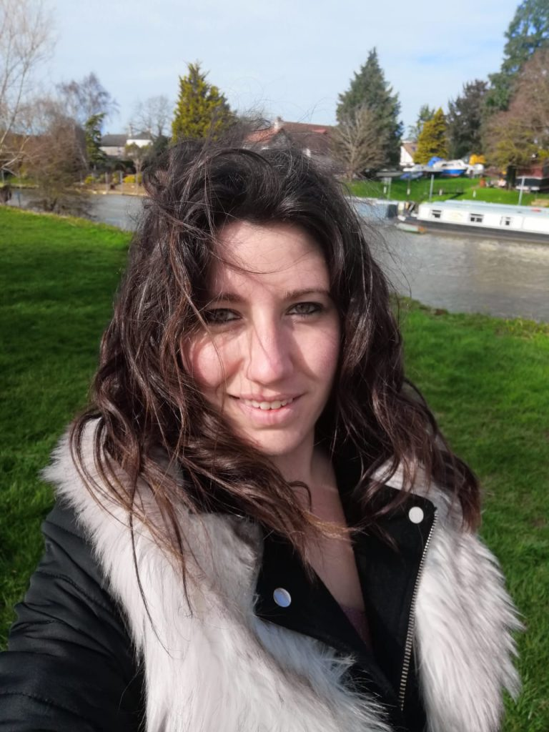
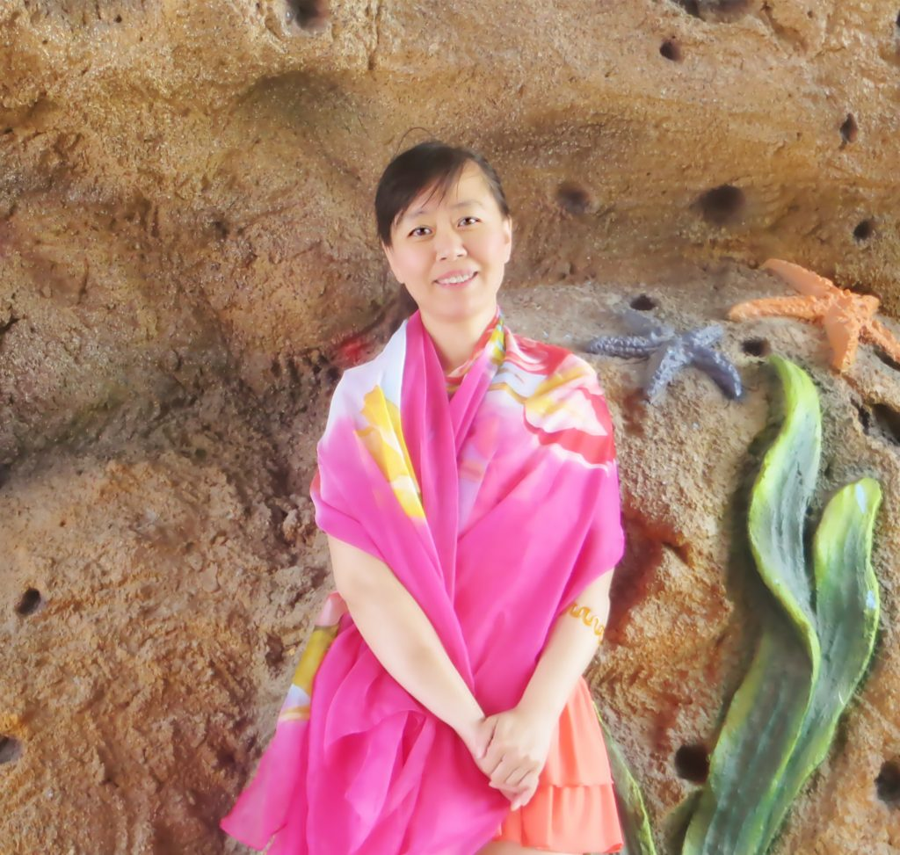
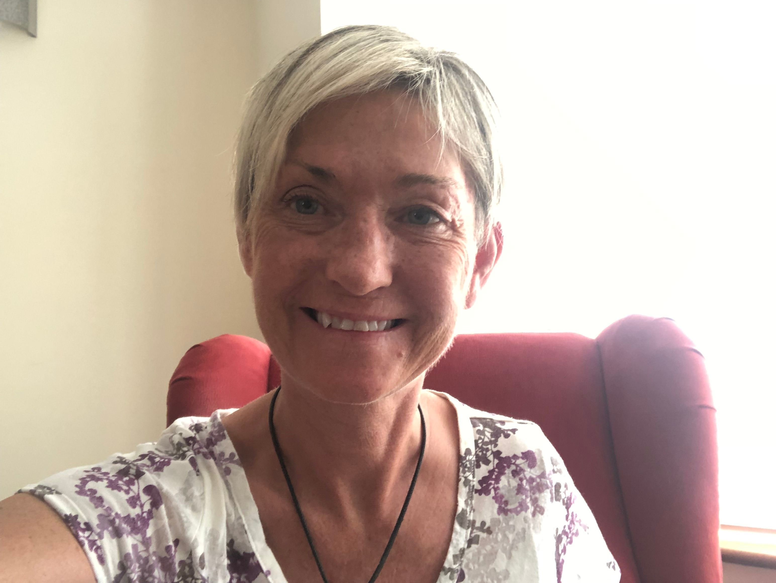
LINGO MIX
LANGUAGE TEAM
A LITTLE BIT ABOUT THE CREATION OF LINGO MIX
2016: Creation of the International Language Café in Milton Keynes, in the UK. I enjoy bringing people together, meeting and practising languages in a social environment (International gatherings, social events, social language workshops), learning about each other’s cultures and expanding our horizons.
2020: French national who has lived in the UK since 2006. Using my background of teaching French and Italian, as well as offering a wide range of world languages with a friendly team , I now offer language courses for all levels.
ANY LANGUAGE QUERIES: MARIEITMM@GMAIL.COM
ENGLISH/ FRENCH/ SPANISH/ ITALIAN/ GERMAN/ MANDARIN/ PORTUGUESE – BRAZILIAN/ POLISH/ GREEK

